Slide 1
PARCEL APP
A modern mobile solution for parcel delivery and tracking
SUJATA MANDAL
SARASWATI KHADKA

Slide 2
INTRODUCTION
A Parcel App is a cross-platform mobile application built using Flutter that allows users to create, book, track, and manage parcel deliveries. The app connects senders, couriers, and receivers in a streamlined workflow with features such as live tracking, secure payment, route optimization, notifications, and order management. It is designed to be user-friendly, scalable, and suitable for small courier services up to enterprise logistics.
Key highlights:
Cross-platform (Android & iOS) using a single codebase.
Real-time tracking and status updates.
In-app payment and order lifecycle management.

Slide 3
PROBLEM STATEMENT
Despite growing demand for fast and reliable parcel services, many small-to-medium courier providers face:
Inefficient manual order handling — paper logs, phone calls, and spreadsheets that cause delays and errors.
Poor tracking transparency — senders and receivers lack real-time visibility into parcel location and status.
Inadequate route & resource optimization — higher fuel/time costs and inefficient assignments.
Limited customer communication — no automated notifications or delivery confirmations.
Payment friction & security concerns — cash-only or unsecured payment flows reduce trust and sales.
These problems reduce customer satisfaction, increase operational costs, and limit growth.

Slide 4
OBJECTIVES
Primary Objective
To design and implement a secure, efficient, and user-friendly Flutter-based parcel delivery app that automates booking, tracking, routing, and payments for courier services.
Specific Objectives
Provide an intuitive UI for customers to book and pay for deliveries.
Enable real-time parcel tracking with location updates for customers and admins.
Implement courier assignment and basic route optimization to reduce delivery time and cost.
Offer admin dashboards for order, courier, and revenue management.
Ensure data security, user authentication, and transaction safety.

Slide 5
SCOPE
User (sender/receiver) registration and profiles.
Courier registration and management.
Order creation, pickup scheduling, and status updates.
GPS-based live tracking and map view.
In-app payments (mobile wallets / card / COD flag).
Push notifications and SMS/email alerts.
Admin panel for reporting and order management.

Slide 6
FEASIBILITY STUDY
1. Technical Feasibility
The Flutter Parcel App is technically feasible as it uses Flutter and Dart to develop a single codebase that runs smoothly on both Android and iOS platforms. It integrates essential tools like Firebase for authentication, database, and notifications, along with Google Maps for real-time parcel tracking.
2. Economic Feasibility
Economically, the project is viable because the development and operational costs are relatively low compared to its long-term benefits. Using open-source technologies like Flutter and Firebase reduces licensing expenses, while automation of booking, tracking, and payment processes minimizes manual labour costs.
3. Operational Feasibility
Operationally, the app is easy to implement and manage. Couriers, administrators, and customers can quickly adapt due to its intuitive interface and automated workflow. The system simplifies parcel management, reduces errors, and enhances communication through instant notifications and live tracking.

Slide 7
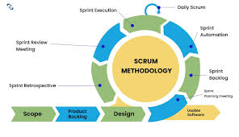
METHODOLOGY

Slide 8
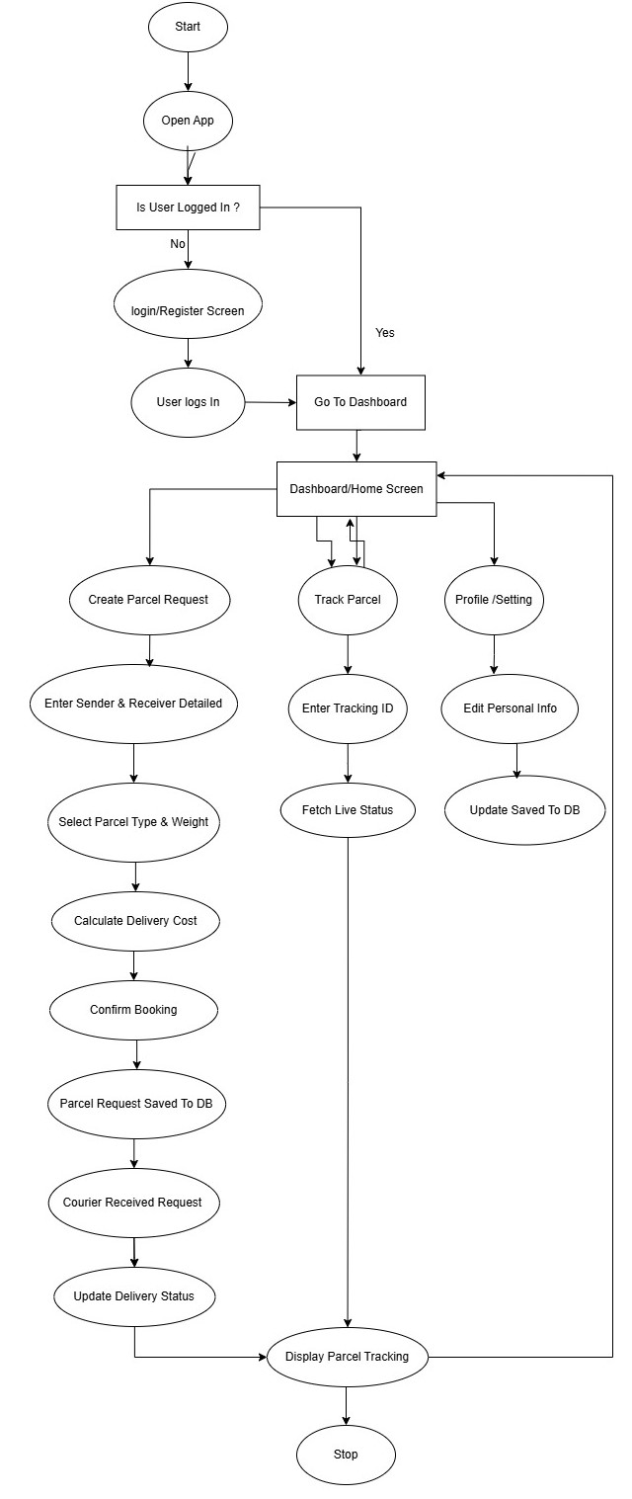
ER-DAIGRAM

Slide 9
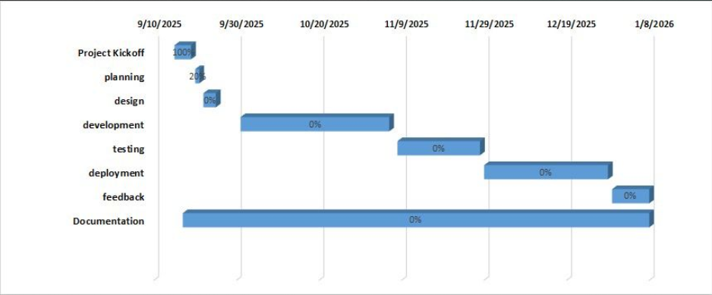
GANTT CHART

Slide 10
REQUIRMENT ANALYSIS
Functional Requirements
These define the core features and operations of the system:
User Management: Registration, login, and profile management for customers, couriers, and admins.
Parcel Booking: Users can create delivery requests by entering pickup and drop-off details.
Tracking System: Real-time GPS tracking of parcels for both customers and admins.
Order Management: Admin can view, update, and manage delivery requests and courier assignments.
Payment Integration: Support for online payments (cards, wallets) and cash on delivery options.

Slide 11
2. Non-Functional Requirements
These specify the quality attributes and system performance expectations:
Performance: The app should load quickly and handle multiple users simultaneously without lag.
Usability: The interface must be intuitive, simple, and easy for all types of users.
Reliability: The system should ensure consistent tracking and data availability with minimal downtime.
Security: All user data and transactions must be encrypted and protected against unauthorized access.
Scalability: The system should support future expansion with more users and delivery areas.
Compatibility: The app should work seamlessly across Android and iOS devices.

Slide 12
Future Enhancements
Add advanced route optimization using AI for faster deliveries.
Integrate multiple payment gateways and loyalty points system.
Include chat support between customers and couriers.
Add multi-language and multi-currency support for wider reach.
Implement analytics dashboard for delivery performance insights.
Enable parcel insurance and digital signature verification.
Expand to web platform for admin and customer access.

Slide 13
Deliverables
Fully functional Flutter mobile app (Android & iOS).
Admin dashboard for order, user, and courier management.
Backend system with database and API integrations.
User documentation and training materials for staff.
Testing reports and deployment package.

Slide 14
Conclusion
The Flutter Parcel App is a reliable and user-friendly solution for managing and tracking parcel deliveries. It simplifies operations for courier companies, enhances transparency for customers, and ensures faster, more secure service. With its scalable architecture and potential for future enhancements, the app can grow into a comprehensive logistics platform that meets the evolving needs of modern delivery systems.

